Slide 1


Meeting Room Booking
Easily find and book the most suitable meeting space.
Project presentation

Slide 2
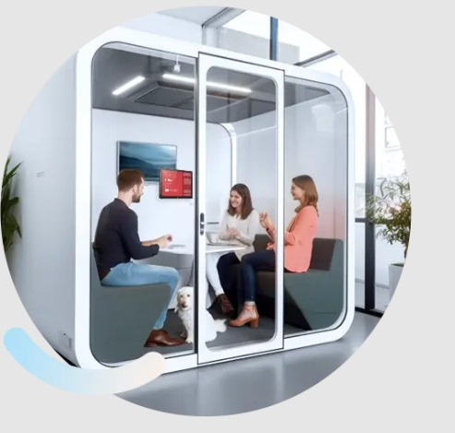
Objective: Develop a user-friendly website to streamline the process of booking meeting rooms within an organization.
Importance: Efficient room booking reduces conflicts, saves time, and enhances productivity.

Slide 3
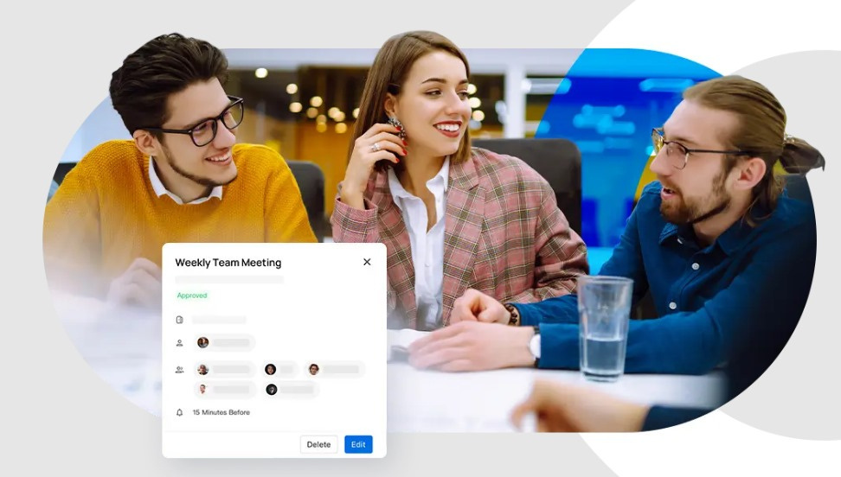
Key Features
User Registration and Login: Secure user authentication.
Room Availability: Real-time view of available meeting rooms.
Booking Management: Users can book, edit, or cancel reservations.
Admin Dashboard: Manage rooms, view bookings, and generate reports.
Credits: credits will be calculated automatically.
Search and Filter: Find rooms based on date, time, and capacity.

Slide 4
System Architecture
Frontend
Frontend: User interface for booking, checking availability, and managing bookings.
Backend
Database
Backend: Business logic for handling booking requests, validation, and data storage.
Database: Stores room details, booking records, user information, and admin data.

Slide 5
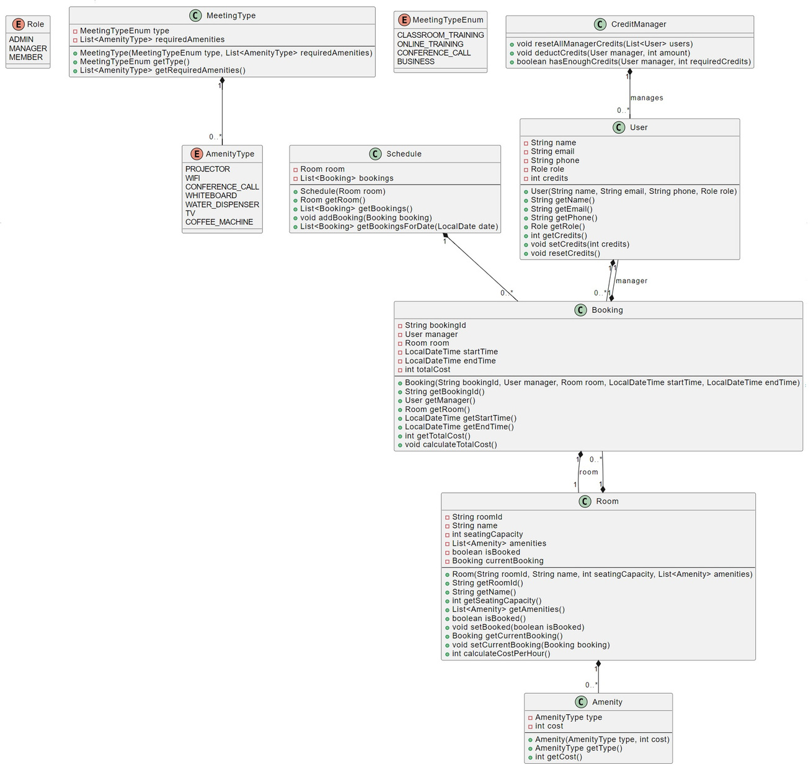
Class Diagram

Slide 6
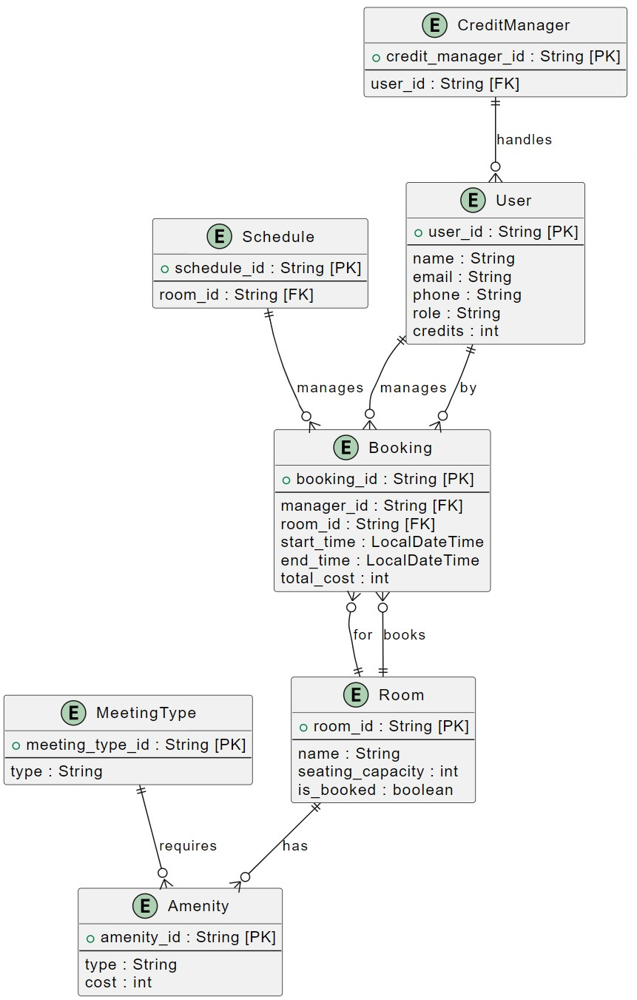
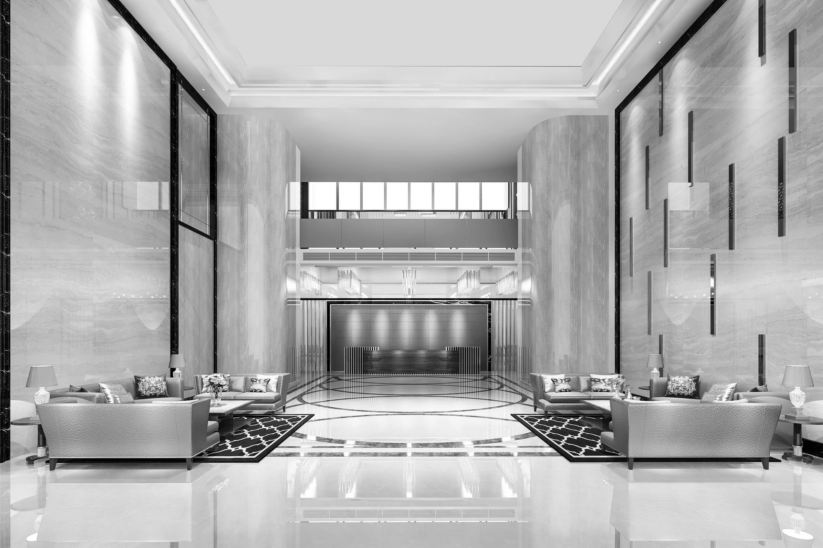
ER-Diagram

Slide 7
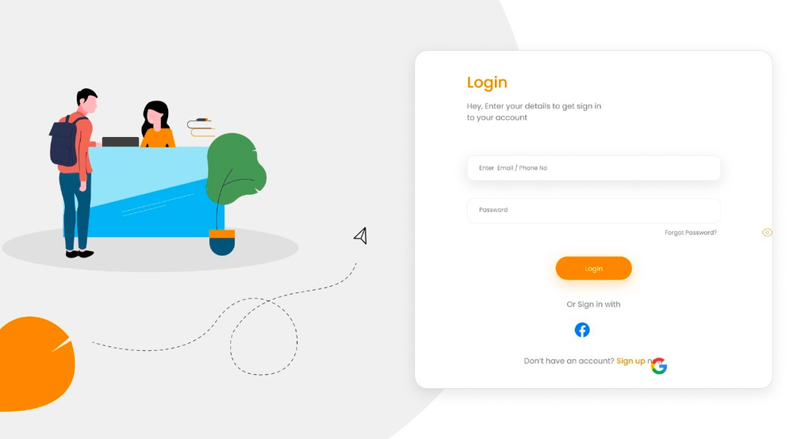
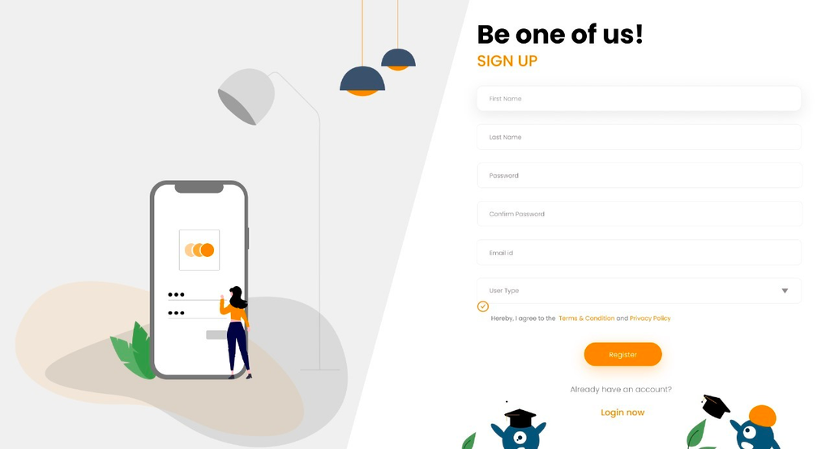
Login and Signup page for secure user authentication and registration, allowing users to access personalized features and manage their bookings.

Slide 8
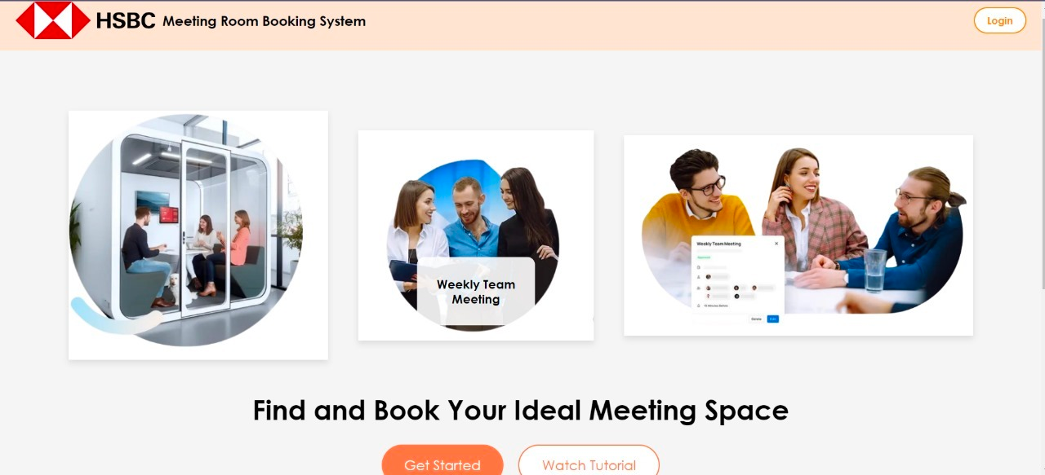
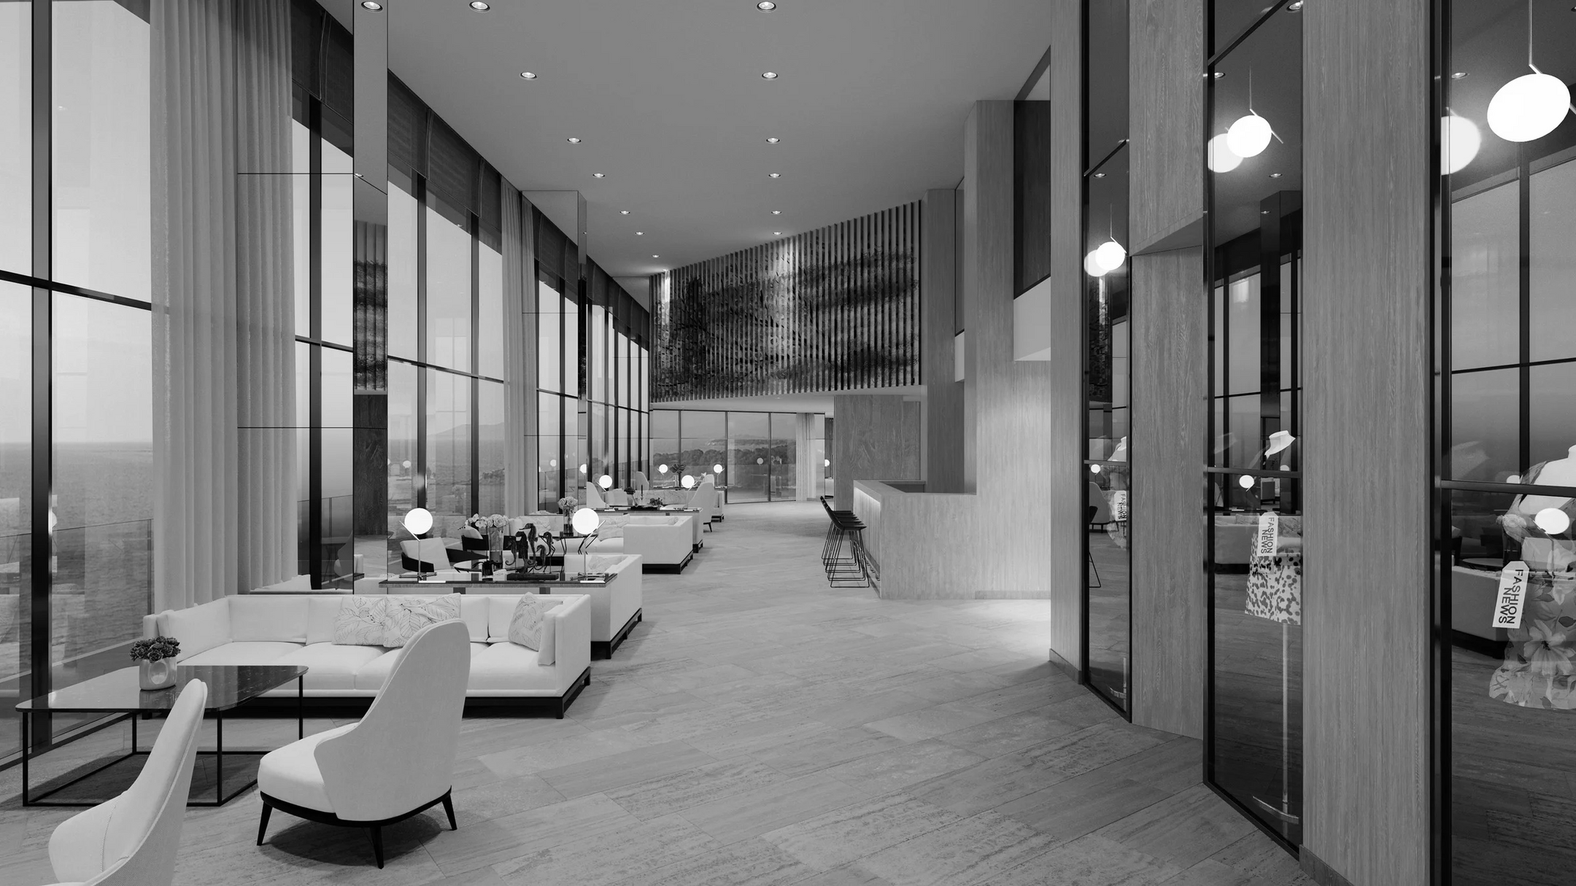
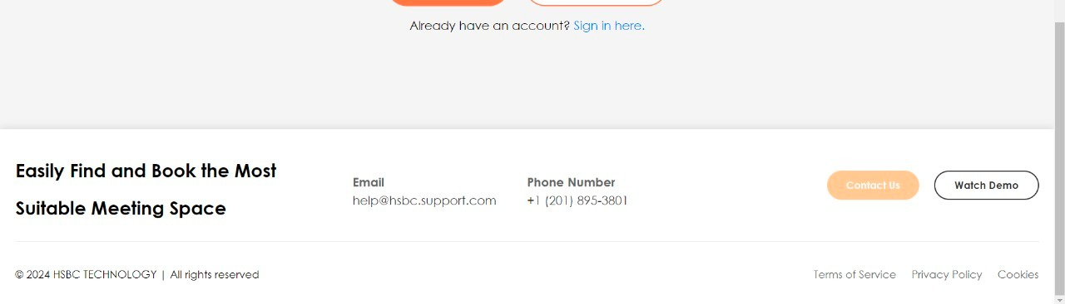
Home page for easy booking

Slide 9
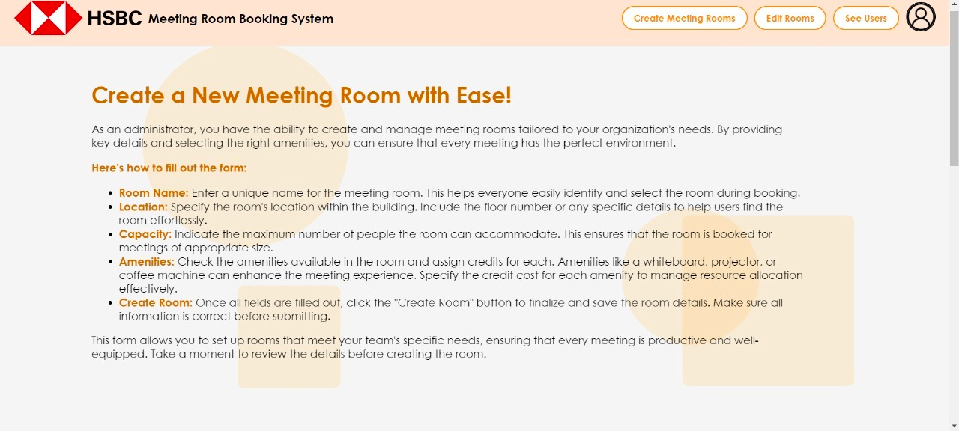
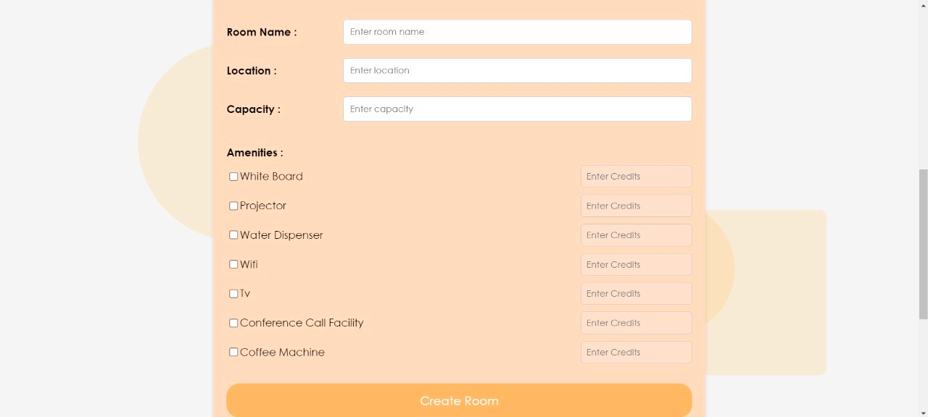
Admin create room

Slide 10
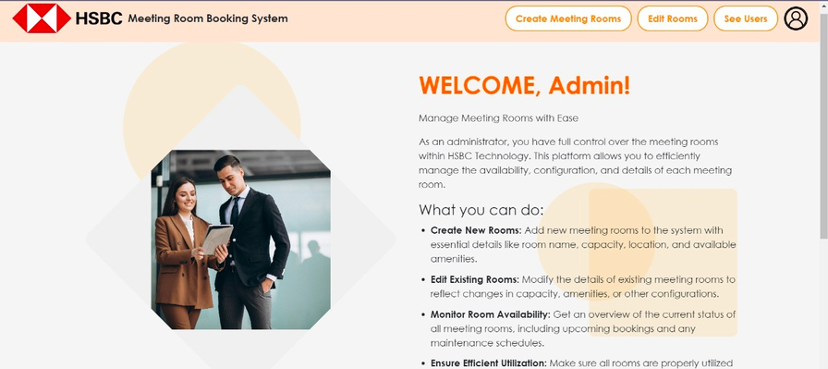
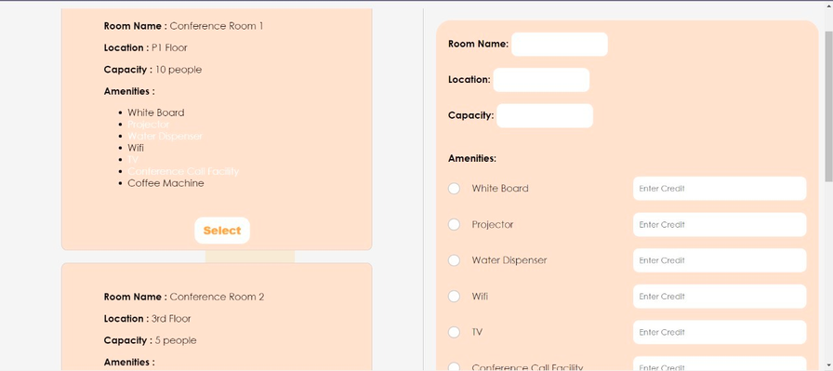
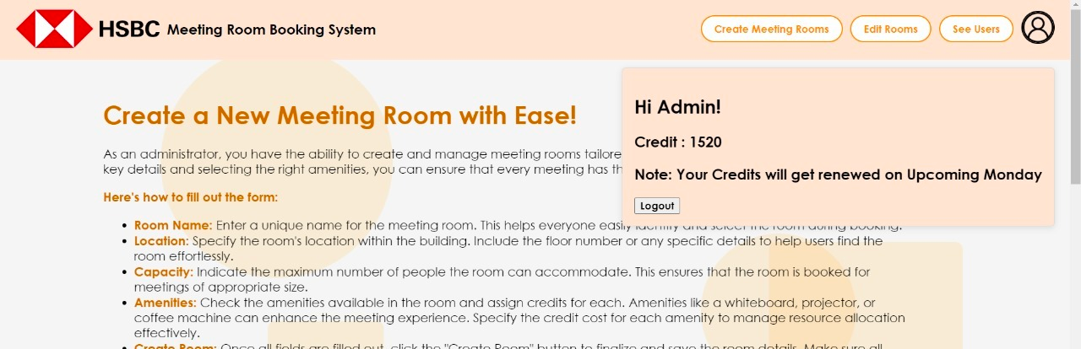
Admin Dashboard
Admin Edit room
Profile

Slide 11
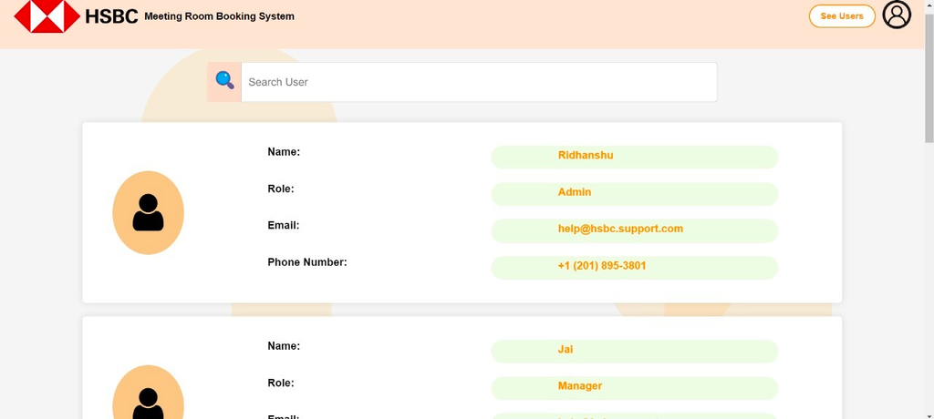
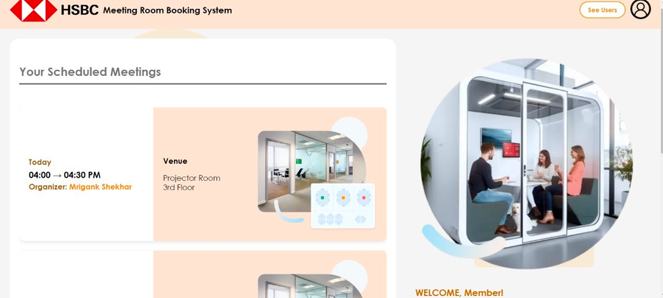
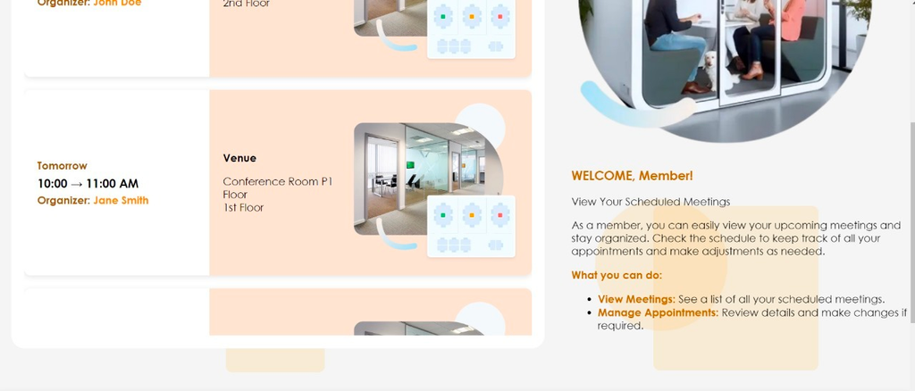

Member Page
See Users
Profile

Slide 12

Team
Aastha Singh
Darpan Mittal
Jai Singh Bisht
Pavan Kumar
Riddhika Shringi
Ridhanshu Jasrotia
Riya Goyal
Sangam Mishra
Zaildar Karamveer Singh

